Slide 1
The Role of Biological Drivers on Fishery Economic Outcomes A Comparison Pre and Post Catch Shares
Todd Lee
Program Manager
Economic and Social Science Research Program
Northwest Fisheries Science Center
NOAA Fisheries – National Marine Fisheries Service (NMFS)
Seattle, WA
Todd.Lee@noaa.gov

Slide 2

Raised in small-town Utah
PhD Economics, UW
UAF Asst. Prof. 2 years
NOAA 16 years
Research: Non-market valuation
Involved in West Coast catch share program development and monitoring since 2007
Pacific Fishery Management Council, Scientific and Statistical Committee (SSC)
Ski, bike, mountaineering, food, IPA, break stuff

Slide 3
VERY Special Thanks!!!
Erin Steiner – EDC data
Beth Horness – Trawl survey data

Slide 4
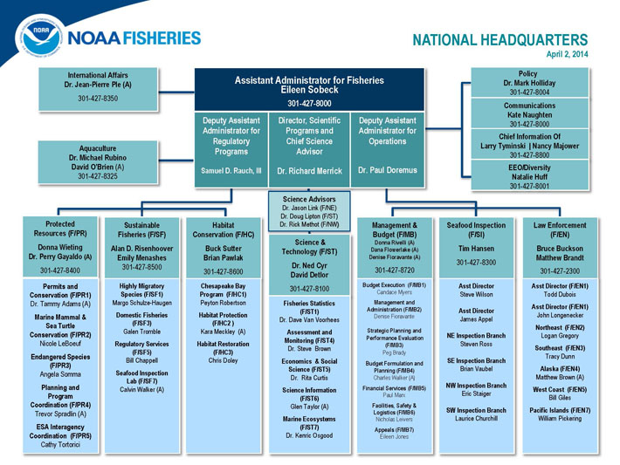
NOAA Fisheries Background

Slide 5
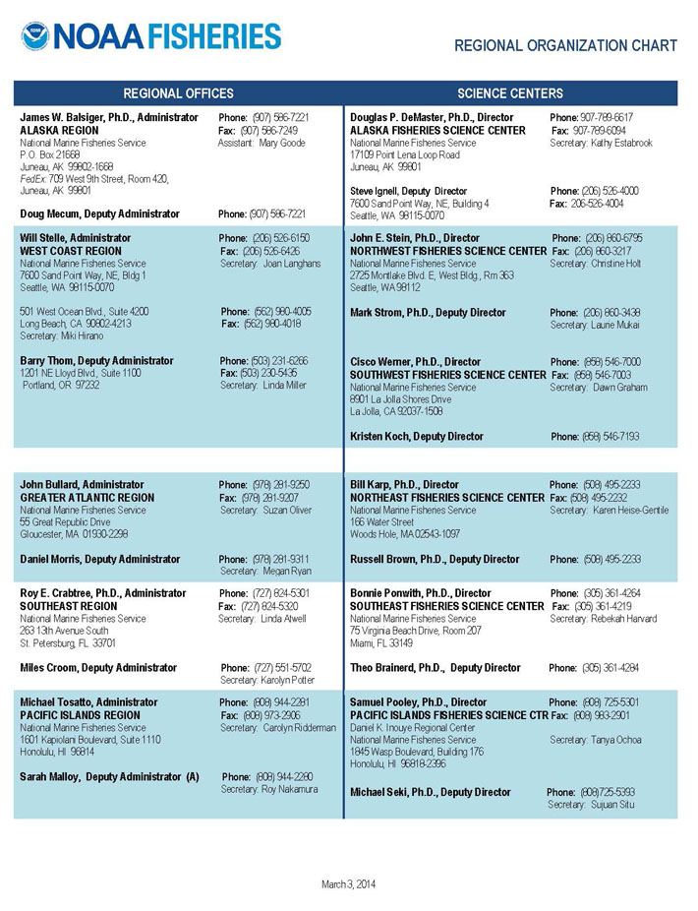
Regional Office and Science Centers

Slide 6
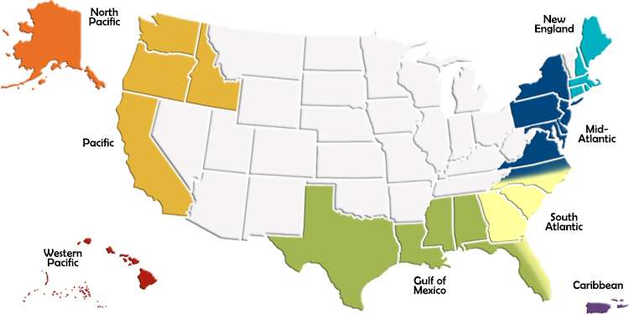
8 Regional Fishery Management Councils
The Magnuson-Stevens Fishery Conservation and Management Act (MSA) created councils responsible for the fisheries that require conservation and management in their region.
Voting and non-voting members representing the commercial and recreational fishing sectors and environmental, academic, and government interests. Under MSA required to:
Develop and amend Fishery Management Plans
Convene committees and advisory panels and conduct public meetings
Develop research priorities in conjunction with a Scientific and Statistical Committee
Select fishery management options
Set annual catch limits based on best available science
Develop and implement rebuilding plans

Slide 7

NWFSC Social Science Programs
2002 N=4 2014 N=15
Projects
Data
Commercial
Recreational
Community
Analysis
Catch shares
Regional economic impacts
Fleet profitability
Recreational demand and value
Behavioral models
Community effects and dependence
Management support
National projects

Slide 8
West Coast Groundfish Fishery
Multispecies groundfish fishery
Three “permit” types
Limited entry trawl permit (THIS PROJECT)
Catcher vessels (shoreside and at-sea deliveries)
Catcher-processors (hake - Pacific whiting)
Motherships (hake - Pacific whiting)
Limited entry fixed gear (pot and longline)
Sablefish most important
Permit stacking program – a type of catch shares
Open access
Rely (some greatly) on other fisheries, including West Coast State and Alaskan fisheries

Slide 9
Limited Entry Trawl Groundfish Fishery
Historical Management < 2011
Issues
Open access
Limited Entry
Buyback
Monthly trip limits
Seasonal closures
Area/Depth closures
Difficult to manage over fished species (Bocaccio, Canary, Cowcod, Darkblotched, POP, Widow, Yelloweye)
Complicated management structure with in season management
Constraining for participants regarding timing
Over capitalization – “race to fish”

Slide 10
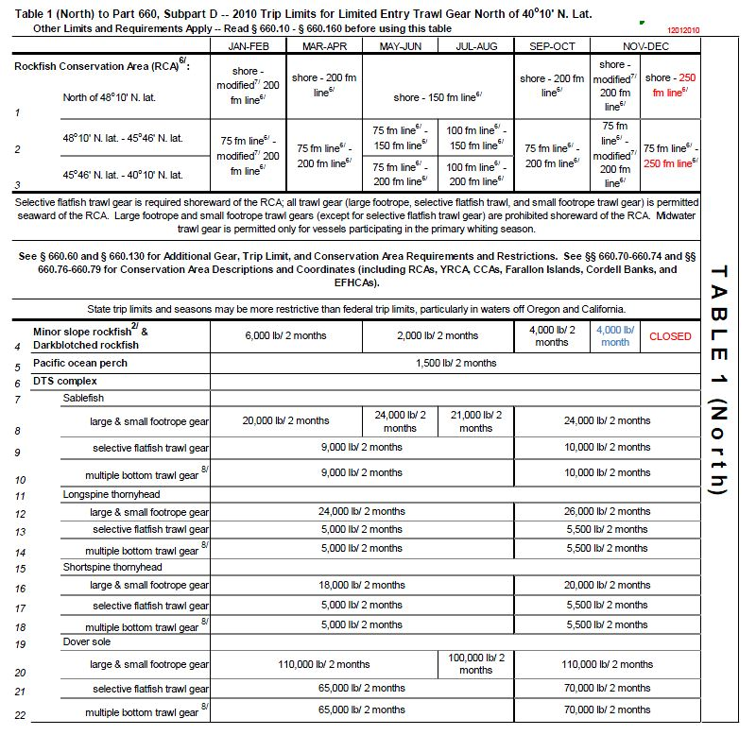
October 2010 In Season Management

Slide 11
West Coast Catch Share Program Limited Entry Trawl Groundfish Fishery
Historical Management
Catch shares: 2011 – present
Open access
Limited Entry
Buyback
Monthly trip limits
Seasonal closures
Area/Depth closures
Individual fishing quotas (IFQs) for shoreside landings
Tradable Quota pounds and quota shares
Initial allocation based on historical participation
Accumulation limits by species/group
Processors received 20% of hake quota
Cooperatives for
Catcher-processors
Motherships
Need to sell entire allocation (not divisible)

Slide 12
Stated Goals and Objectives
Goal
Create and implement a capacity rationalization plan that increases net economic benefits, creates individual economic stability, provides for full utilization of the trawl sector allocation, considers environmental impacts, and achieves individual accountability of catch and bycatch.
The above goal is supported by the following objectives:
Provide a mechanism for total catch accounting.
Provide for a viable, profitable, and efficient groundfish fishery.
Promote practices that reduce bycatch and discard mortality and minimize ecological impacts.
Increase operational flexibility.
Minimize adverse effects from an IFQ program on fishing communities and other fisheries to the extent practical.
Promote measurable economic and employment benefits through the seafood catching, processing, distribution elements, and support sectors of the industry.
Provide quality product for the consumer.
Increase safety in the fishery.

Slide 13
Constraints and Guiding Principles The above goals and objectives should be achieved while the following occurs:
Take into account the biological structure of the stocks including, but not limited to, populations and genetics.
Take into account the need to ensure that the total OYs and allowable biological catch (ABC) are not exceeded.
Minimize negative impacts resulting from localized concentrations of fishing effort.
Account for total groundfish mortality.
Avoid provisions where the primary intent is a change in marketing power balance between harvesting and processing sectors.
Avoid excessive quota concentration.
Provide efficient and effective monitoring and enforcement.
Design a responsive mechanism for program review, evaluation, and modification.
Take into account the management and administrative costs of implementing and oversee the IFQ or co‑op program and complementary catch monitoring programs, as well as the limited state and Federal resources available.

Slide 14
“Expected” Economic Effects of Catch Shares
Fleet consolidation
Less efficient vessels/operators would tend to leave
Remaining fleet more profitable
Regional economic impacts would decrease, ceteris paribus. Could be mitigated by:
increased expenditures by those remaining
Increased attainment of TAC
Other
Fewer crew positions, perhaps more hours/position
More flexibility, along many margins, would increase vessel profitability
Vessels could have more bargaining power with processors. Big debate before enactment regarding “stranded capital”.
Development of more custom, specialty markets
Vessels have more freedom to avoid bad weather
Owners of quota act more as stewards of the fishery resource

Slide 15
Notable Features
Multispecies (including bycatch species)
Mandatory observer coverage on all vessels
Partial public funding in first 3 years. Expected to be entirely industry funded in the future.
Newly required First Receiver Site License with shorebased monitoring
All catch of IFQ species counted against quota
Carry-forward and carry-back provisions
Gear switching
Actual gear switching
Permit switching
No quota share trading for first 3 years
No owner on board requirement
10% for adaptive management (initially allocated to quota holders)
5-year review (MSA requirement)
Mandatory Economic Data Collection
Catch vessels
Catcher-processors
Motherships
First receivers and shorebased processors

Slide 16
Notable Occurrences
There is not “full attainment” of many species
More permit-switching than gear-switching
Market for quota pounds developed quickly
Positive quota prices with excessive quota
Some OFS trade at fixed rate (e.g., $50 a pound)
Rick pools have developed
New trawl gear being used
Participants maintaining diversification of fishery participation (not specializing)
Less fleet consolidation than expected – maybe
Movement for electronic monitoring on board vessels

Slide 17
The Project and Data
Aggregate the economic information to the port level for 2009-2012
Look at catcher vessels delivering shoreside
Aggregate species and posts as necessary to preserve confidentiality
Obtain biological information from the NMFSC Trawl Survey that shows CPUE 2009-2012
Is there evidence that the biology is driving economic outcomes? In addition, has the relationship change pre/post catch share implementation?
The GOOD news, and the bad…

Slide 18
Economic Data Collection (EDC)
Annual form required to obtain limited entry trawl permit
Due September 1st of each year (2013 data due in 6 days!)
Began with the collection of 2009 and 2010 data in 2011
Data
Owner information
Vessel characteristics
By fishery/activity: days at sea, crew size, speed, fuel use
Capital costs (annual)
Expenses (annual)
Activities in other fisheries
Permit and quota sells/purchases
Crew share system
QA/QC with call backs
The Form

Slide 19
EDC Analysis
Break costs into variable and fixed
Designate fisheries
At-sea whiting
Shoreside whiting
DTS trawl
Non-whiting, non-DTS trawl
Fixed gear with trawl endorsement
Fixed gear with fixed gear endorsement
Other (e.g., crab, shrimp, halibut, salmon, tuna)
Shrimp
Alaska
Disaggregate cost into fisheries for variable costs and fixed costs
Calculate Variable Cost Net Revenue and Total Cost Net Revenue

Slide 20
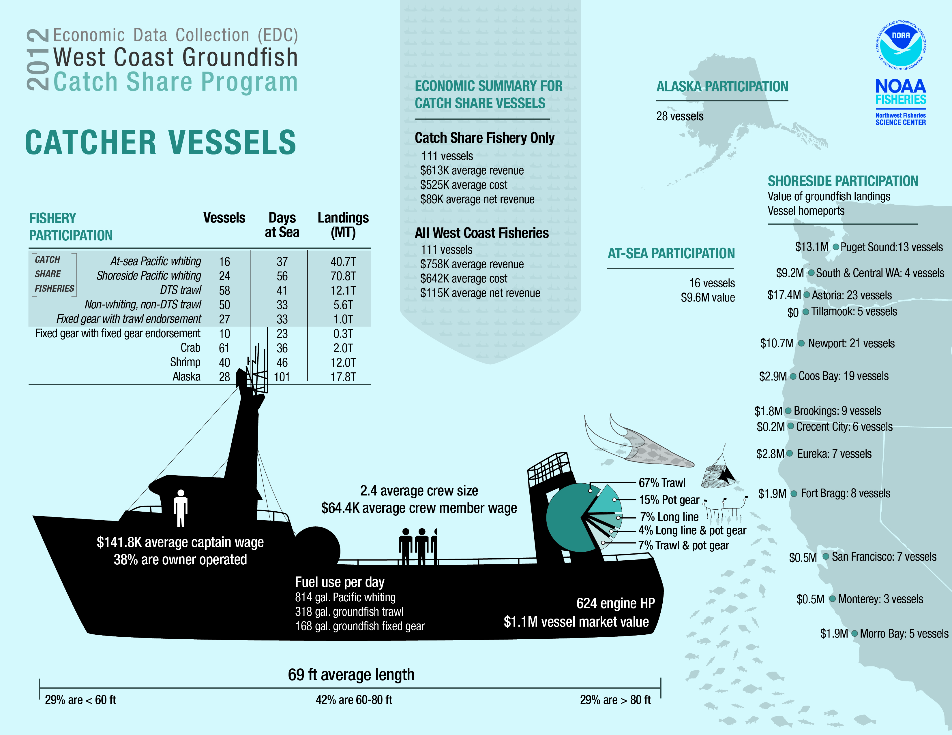
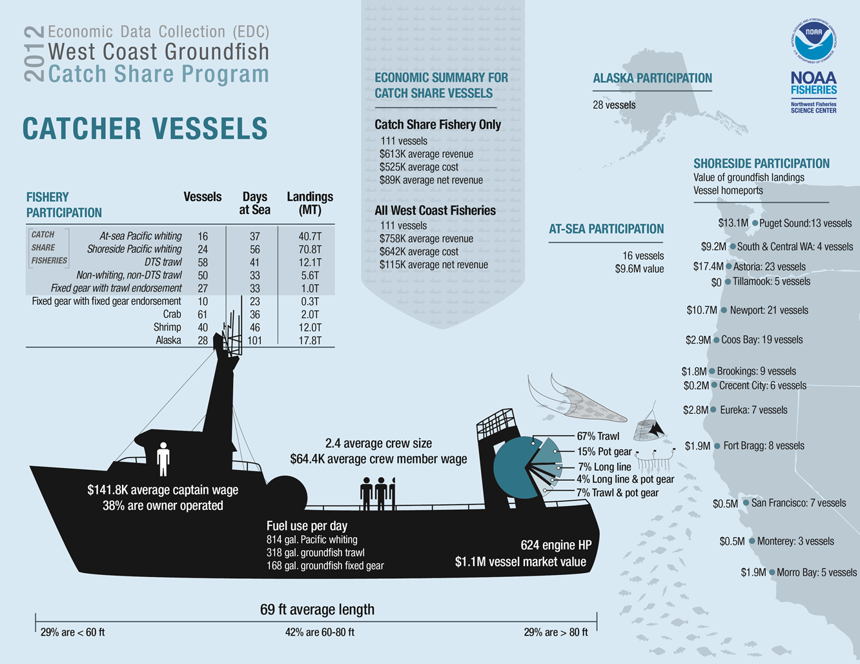
DRAFT
DO NOT USE

Slide 21
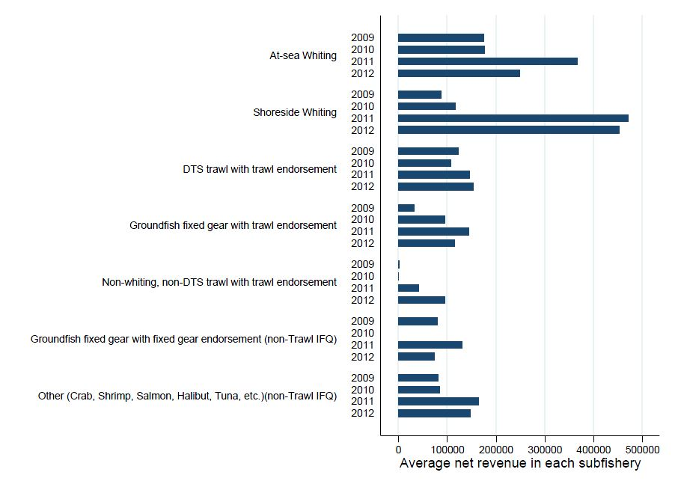
Average Net Revenue by Sub-fishery

Slide 22
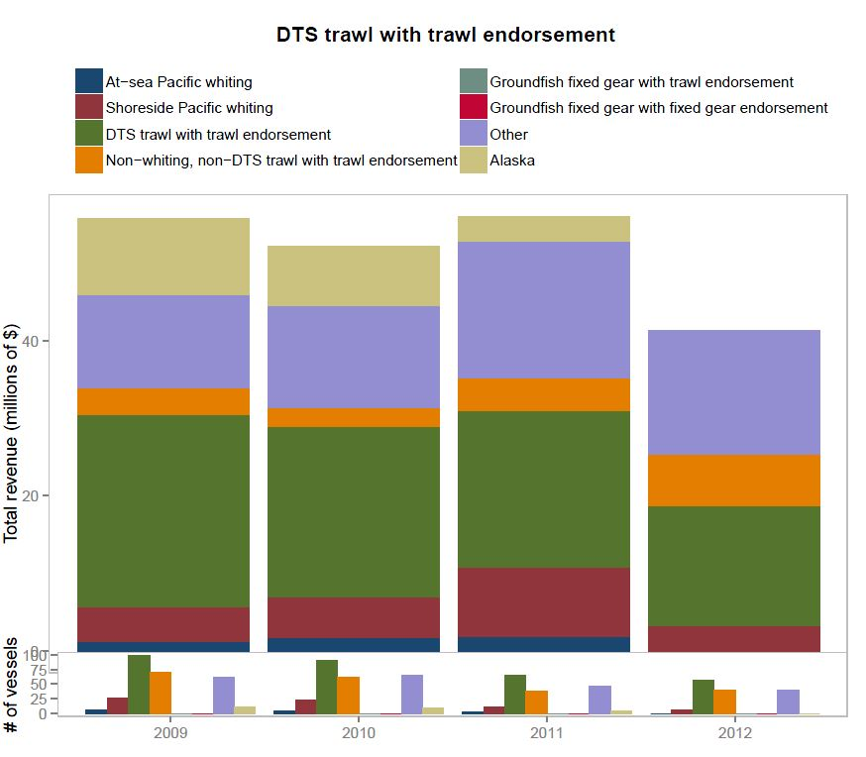

Slide 23
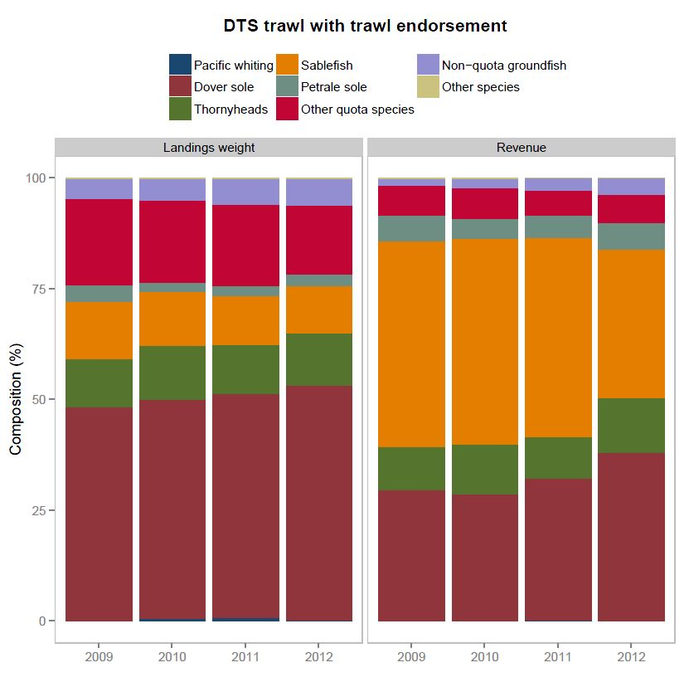

Slide 24
Economic Data
Ports:
Astoria and Tillamook
Brookings and Crescent City
Coos Bay
Eureka
Fort Bragg
Monterey and Morro Bay
Newport
San Francisco and Bodega Bay
Washington State
Species
Rockfish
Flatfish
Other groundfish
Dover sole
Thornyheads
Sablefish
Petrale sole
Sharks, skates and rays
EDC data by port and year (note: vessels are assigned to one, and only one, port)
Number of vessels
Number of processors
Ave. vessel characteristics by gear (HP, fuel capacity, length, #vessels)
Ave. vessel activity by gear (crew, fuel use, speed, days, #vessels)
Costs by gear (FC, VC)
Net revenue by gear (total revenue, VCNR, TCNR)
Excluded at-sea and shorebased whiting
Fish ticket data by year and port
Landings by species/group
Revenue by species/group

Slide 25
Trawl Survey Data
See the Technical Report (2005)
Catch by species (species group) per unit effort for each tow
Timing of the survey (late spring to early fall) versus when fishing effort takes place
The trawl survey includes areas closed to fishing

Slide 26
Some Thoughts…
What does the economic data say by itself (this alone is useful)? Are there changes year-to-year? Changes since IFQ began?
What does the trawl survey data say by itself? Are there changes year-to-year? Changes since IFQ began?
A big challenge is how to group the trawl survey data into areas fished from a particular port or port area. How far can they go? Does it make sense for areas to overlap? Straight lines between ports?
Try grouping (averaging) pre/post IFQ data
Have there been changes post IFQ (adjustment to new management regime)?
What are the key economic variables of interest? Are some hypothesized to be more affected by the biology than other?
Think about what are dependent vs independent variables
Calculate prices/lbs
Try adjusting for total quota pounds
Try adjusting for percent attainment

Slide 27
Some More Thoughts…
Keep in mind changes in constraints and incentives due to change in management. Some examples:
The only way a port could have increased lands pre-IFQ was to have more vessels
Old management/limits/closures were intended to prevent overfishing and meant that full attainment was often not possible
Targeting certain species and avoiding other species is more likely under catch shares.
Incentives to reduce bycatch. Gear changes affect bycatch. Don’t have the relevant data on gear modification use.
Remember, you are looking for tendencies, signals.
Be willing to drop stuff that’s not really working out. Step back at times and look at the big picture
Use (primarily) the skills you have
Communicate with your team members, then communicate some more
Write down and explain the next steps. Where should the project go? What are the strengths and weaknesses of what you did? What worked in the process, what did not (broadly). What additional data did you wish you had?

Slide 28
Alternative Title No. 2 How Does Fishing Behavior Change Due to Catch Shares and Biological Constraints?

Slide 29
A Primer on Economic Analysis The Two Most Common Methods Are Very Different
Welfare analysis (benefit-cost analysis, net benefits)
Value of something: add up the net benefits to all members of the relevant population (easiest to use $)
Compare several states of nature: the difference between the value of each state
Types
Consumers (individual people): net value of purchasing (or being handed) something. Depends on substitutes, income, what you already have, preferences, timing, anything that matters
Producers (businesses): profit or net revenue. Depends on costs and revenue (prices, quantities, technology)
Economic Impacts (input-output models)
Measures the economic contribution of an activity (e.g., fishing, building a stadium) on employment, income and output within a regional economy (country, state, county, city/port)
Can compare multiple states of nature
Input-output models use base information that describes economic linkages throughout the relevant economy.
Measures Direct, Indirect and Induced contributions to employment, income and output.

Slide 30
A Primer on Economic Analysis (cont’d) The Two Most Common Methods Are Very Different
Bottom line for fisheries management applications
Net benefits measures whether a policy makes people better or worse off, and by how much
Economic impacts measure the effect of a policy on employment, income and output.
They are not necessarily correlated
Examples
An increase in TAC
A new marine protected area
Open access to IFQ management
Napa earthquake

